Slide 1
Adding a System Call
– Sireejaa

Slide 2
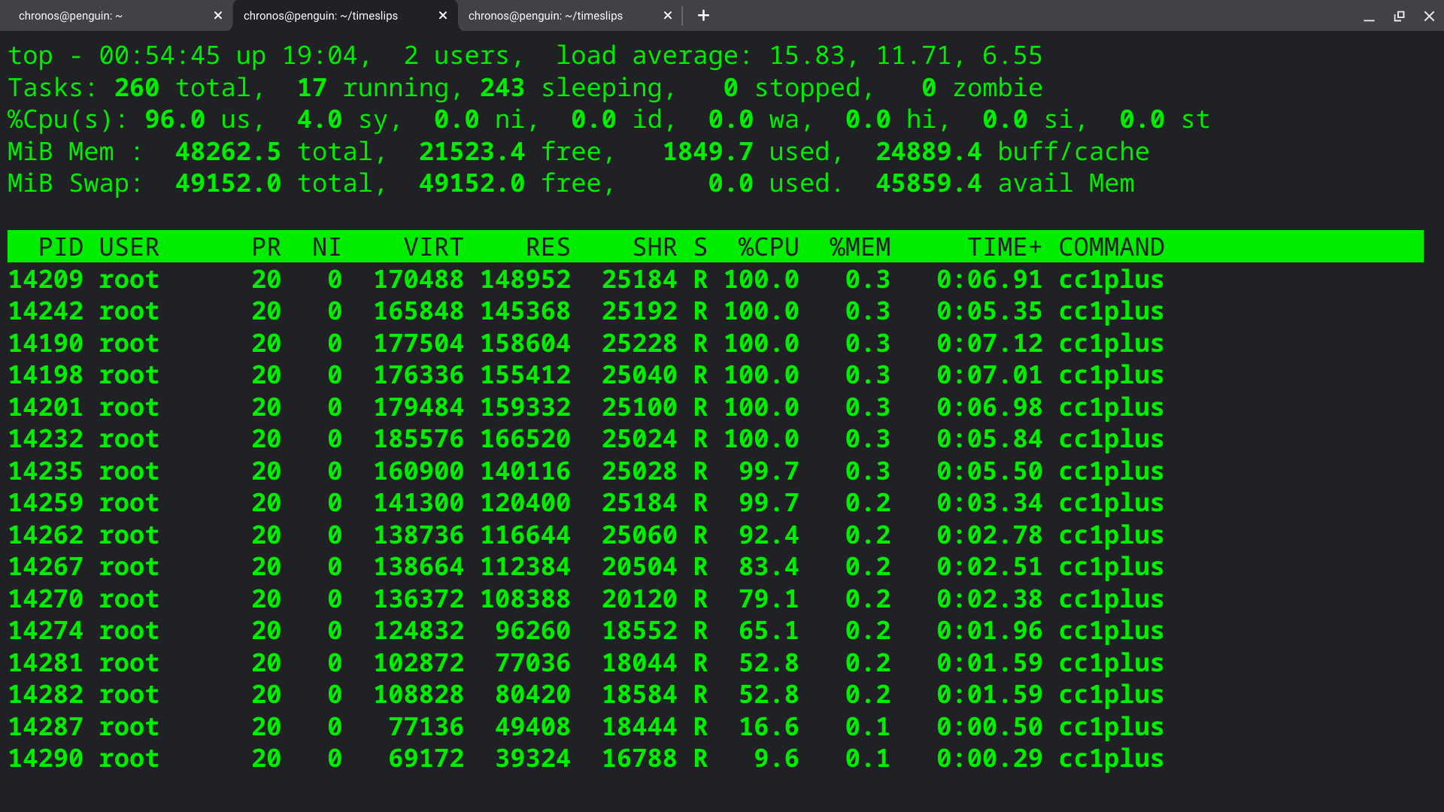
ADD a system call to XV6 OS
The system call, named "cps," allows for the retrieval and printing of the current state of a process within the operating system. This essential function provides valuable insights into the operational status and characteristics of a given process, facilitating debugging, monitoring, and system analysis by revealing crucial information about the process's execution and resource utilization.

Slide 3
Syscall.h and defs.h
In XV6, an educational operating system, syscall.h is a header file that defines system call numbers and their corresponding function prototypes. System calls are essential interfaces for user-level programs to request services from the kernel, such as file operations and process management. The file ensures correct system call usage by specifying system call numbers and function prototypes.
In XV6, defs.h is a header file that contains various definitions, macros, and data structures used throughout the operating system's codebase. It provides essential declarations and constants that are widely used by different components of XV6, making it a central file for maintaining consistency and clarity in the source code.

Slide 4



Update the System Call Table:
In syscall.h, add an entry for your system call in the system call table. This table maps system call numbers to their corresponding functions.
He recently opened a camera shop near the Louvre in Paris.
Visitors to his store, mostly tourists, speak many different languages making anything beyond a simple transaction a challenge.

Slide 5
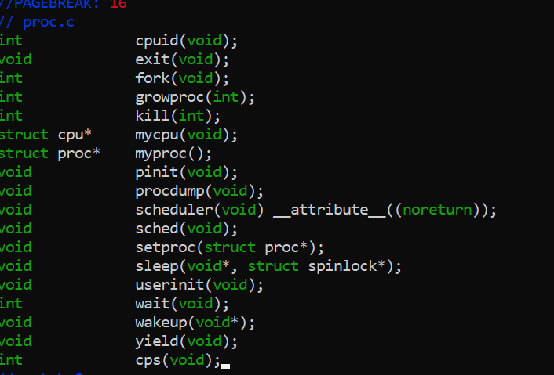
Declare the function and write code for it in defs.h:
To add a new function in proc.c, declare the function first with a prototype, e.g., void myFunction(void);. Then, implement its functionality within proc.c. This function should include the code to perform its intended task, following the conventions and structures used in the xv6 operating system.
He recently opened a camera shop near the Louvre in Paris.
Visitors to his store, mostly tourists, speak many different languages making anything beyond a simple transaction a challenge.

Slide 6
user.h and sysproc.c
In the xv6 operating system, user.h is a header file that contains important declarations and definitions related to user-level programs and system calls. It serves as a bridge between user programs and the xv6 kernel, providing access to system call prototypes and other constants that are used by both user-level programs and the kernel. user.h typically includes declarations for system calls, constants like error codes, and function prototypes that user programs can use to interact with the kernel. This header file is essential for ensuring proper communication and interaction between user-level code and the operating system's kernel in xv6.
In the xv6 operating system, sysproc.c is a critical source code file responsible for implementing system calls. It contains functions that handle user program requests, validate arguments, interact with the kernel to perform operations like process creation and file management, and manage error handling and context switching. This file serves as a pivotal link between user-level programs and the kernel, enabling the core functionality and interaction between the two within the xv6 operating system.

Slide 7
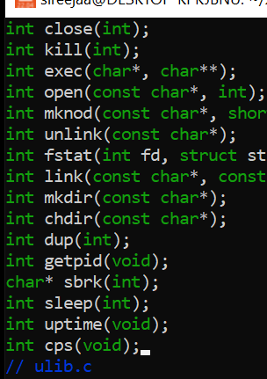
Add function prototype to user.h

Slide 8
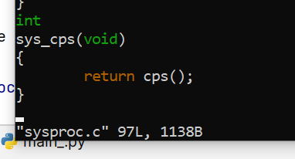
Add function call to sysproc.c

Slide 9
usys.S and syscall.c
In XV6, `usys.S` is an assembly language source file that contains user-level system call wrapper functions. These wrapper functions are used to interface between user-level applications and the kernel when making system calls. Each wrapper function in `usys.S` corresponds to a specific system call and helps ensure that the user-level program interacts with the kernel correctly and securely.
In XV6, syscall.c is a C source file that contains the implementation of the system call handler. It plays a critical role in handling system calls made by user-level applications. The code in syscall.c is responsible for interpreting the system call number and invoking the corresponding kernel function to perform the requested operation, such as file I/O, process management, or memory management. This file is a key component in providing the interface between user-level programs and the operating system kernel.

Slide 10

Add this to usys.S
Tip
The extension is capital ‘S’

Slide 11

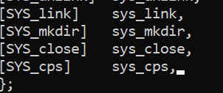
Add actual function to syscall.c

Slide 12
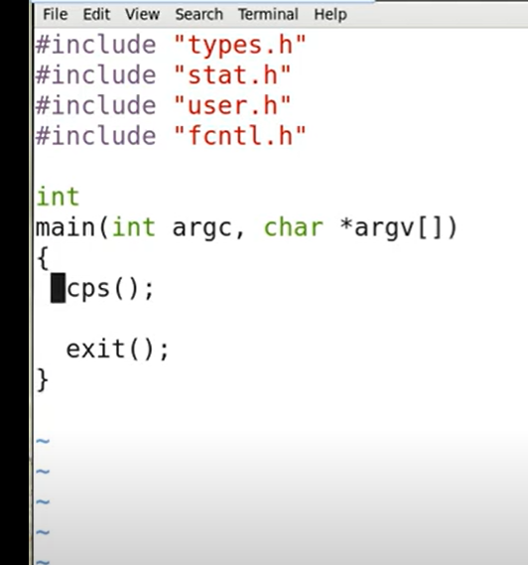
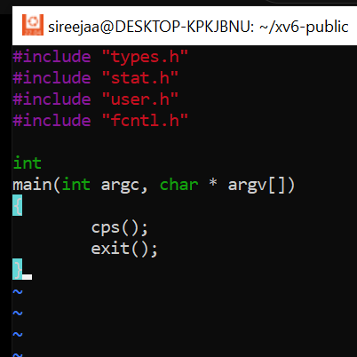
Create another file ps.c
Application that actually calls cps

Slide 13
Create another file ps.c
It is the Application that actually calls cps

Slide 14
Makefile
XV6, the Makefile is a crucial component used for building and compiling the operating system kernel, user-level programs, and various parts of the system. XV6's Makefile is used in the context of its build system and includes rules and instructions for compiling the kernel and user-level programs.
The XV6 Makefile typically includes rules for building the kernel, libraries, and user programs. It specifies compiler options, flags, and dependencies. For example, the Makefile might have rules for building the kernel image, which includes compiling various kernel source files and linking them together. It may also include rules for compiling user-level programs or device drivers.

Slide 15
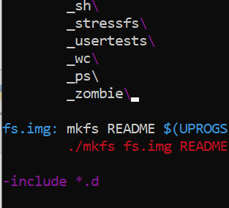
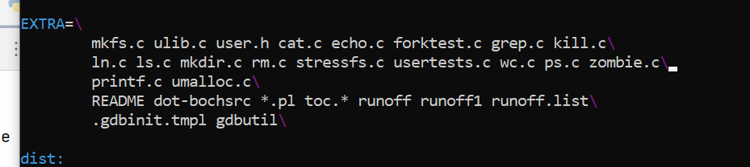
Modify the Makefile

Slide 16
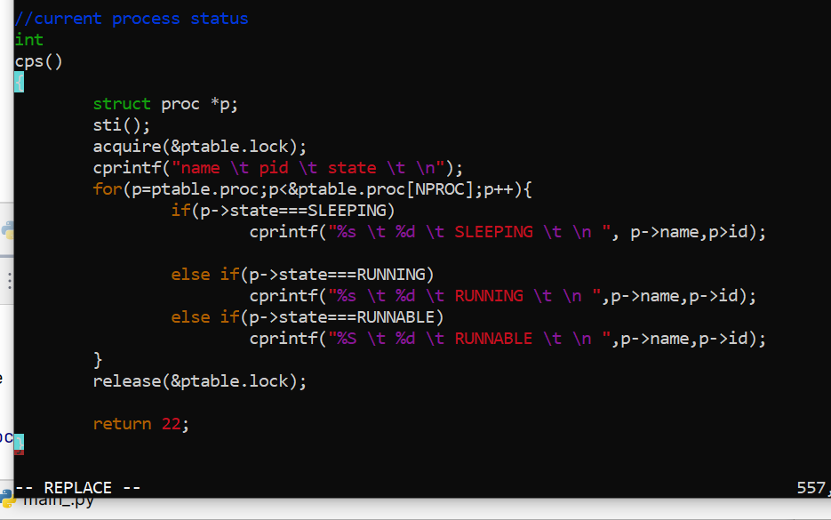
Tip
Incase of errors
Rename p->id to p->pid
Add code to proc .c

Slide 17

Make->resolve errors
Make qemu-nox
Tip
Incase of errors recheck all the previous staements

Slide 18
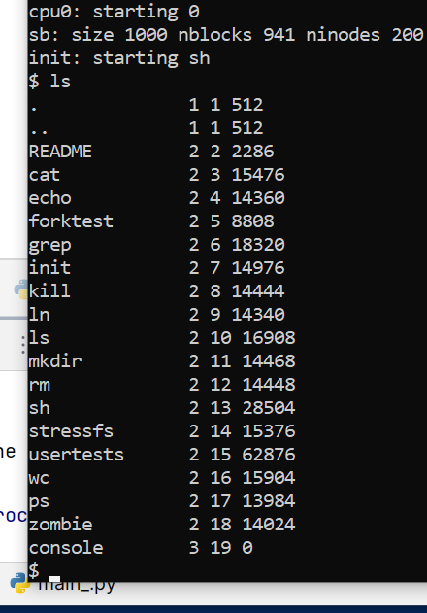
ls command’s output
It lists our ps also.

Slide 19
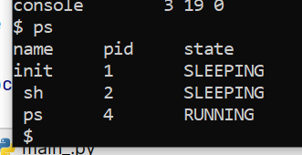
ps command’s output
Here, the output shows the three processes in the system, two of which are in sleeping state and one is running.

Slide 20
Thank You!

